Slide 2
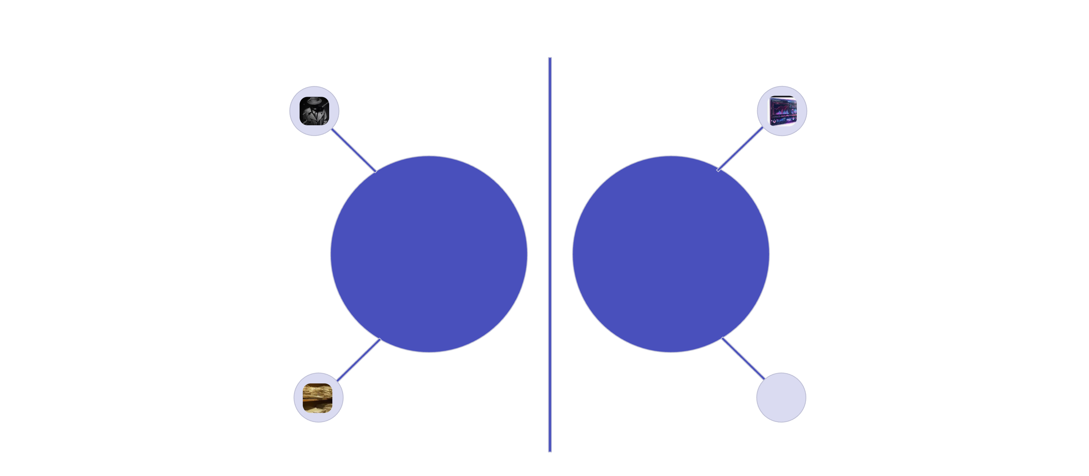



The Case of the Hidden Mule Network
Trench coat & fedora
Holographic dashboards
Analog Investigator
Digital Investigator
Dusty file cabinets
Network graph visualizer
Rahul Mehta suspected of running a mule network
Question: Who else looks like him?

Slide 3
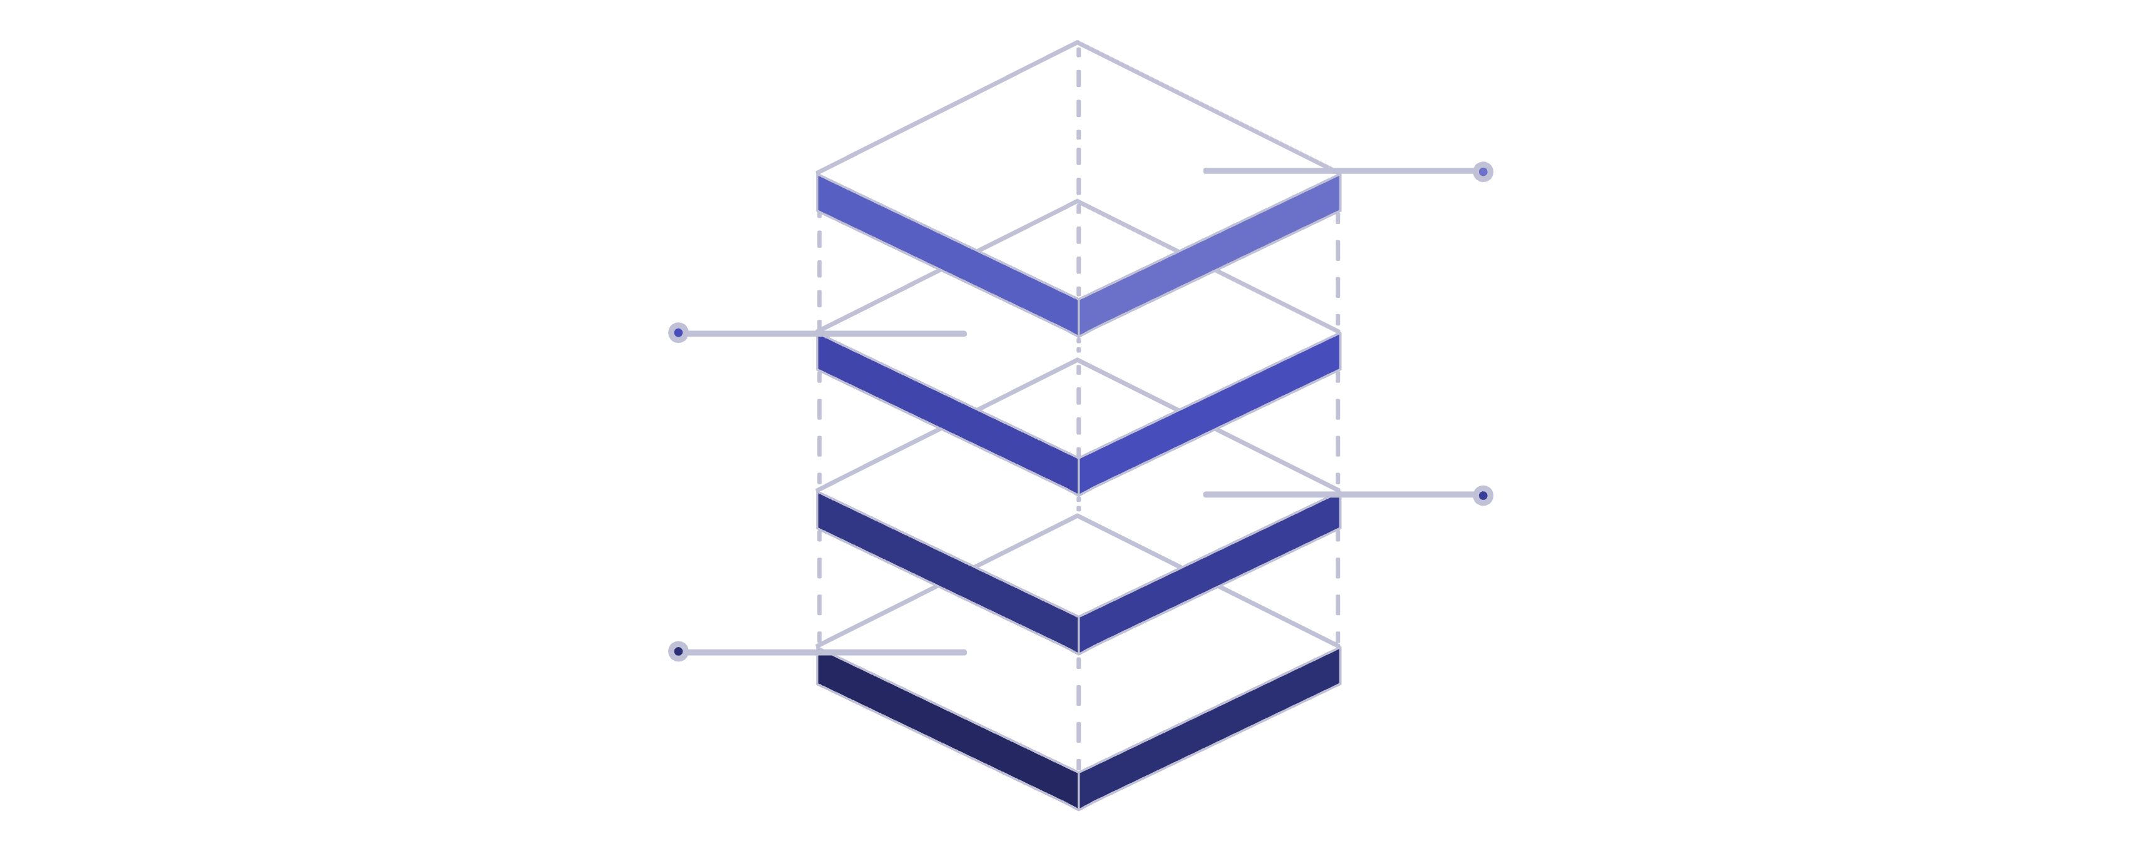
Inspector Rao and the Traditional Database
The Old Way: Exact Match World
No Similarity Detection
Prominent red stamp: ❌
Single Record
Rahul Mehta, Mumbai, ABC123, 92
Isolated Rows
Strong barriers prevent any links
Rigid Table
Outdated SQL table with strict rows

Slide 4
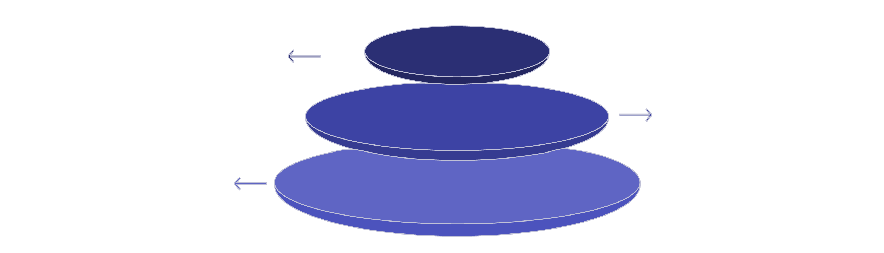
The New Way: Meaning-Based Search
Inspector Maya and the Vector Database
Rahul Mehta → [0.12, 0.88, 0.34, 0.67, 0.91]
Find customers closest to this vector
Central Profile
Rahul Mehta highlighted in red
Nearby Cluster
Luminous, tightly packed customer dots
Similarity Label
92% Similar Customers Found

Slide 5
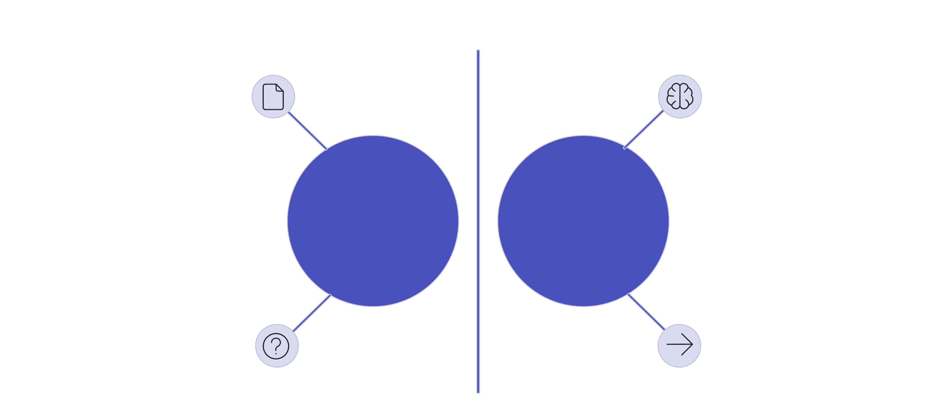



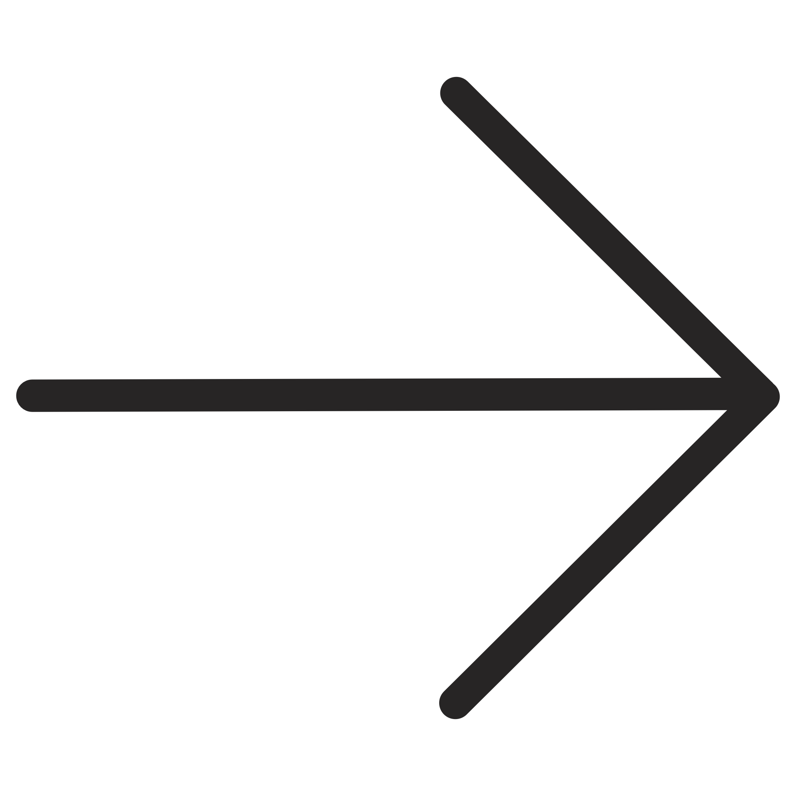
Why Vector Databases Are Needed in AML
AML Is a Pattern Crime, Not a Lookup Crime
Exact match lookup
Similarity search
Traditional DB
Vector DB
Is this equal?
How similar is this?

Slide 6
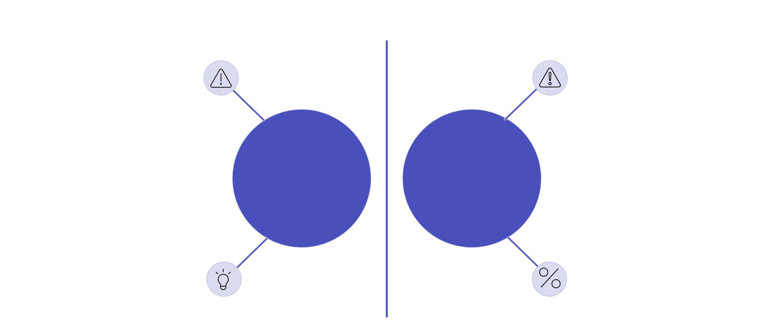




The Criminal You Couldn't See — Now You Can
The Power Moment
Red warning
Red warning
Rahul Mehta
Amit Sharma
Similarity: 94%
Match indicator
Traditional databases store facts. Vector databases store meaning. Financial crime hides in meaning.

Slide 7
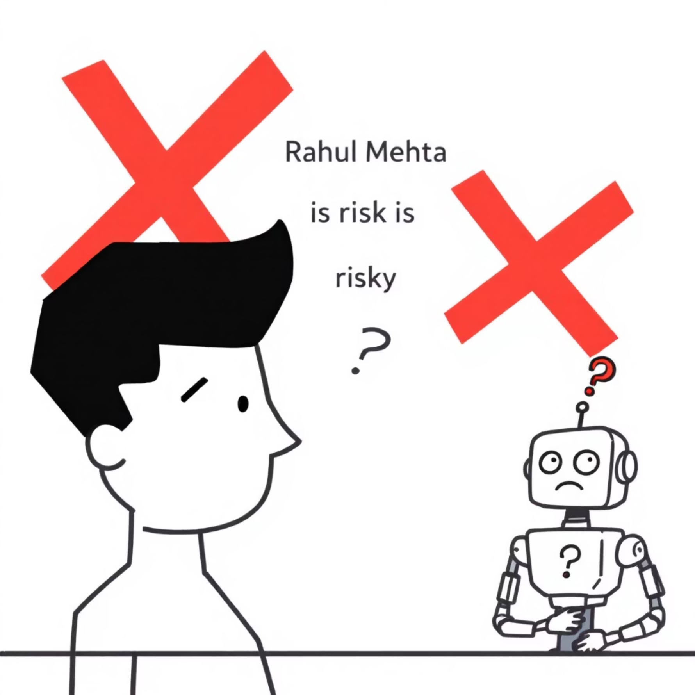

Teaching a Computer to Understand a Customer
When meaning is unclear
Converting meaning to numbers
Computers struggle to interpret human language and intent directly, leading to confusion when faced with subjective statements like "Rahul Mehta is risky."
By converting human language into numerical vector representations (vectorization), computers can process and understand context, leading to clearer, more accurate interpretations.
Meaning → Numbers (Vectorization)

Slide 8
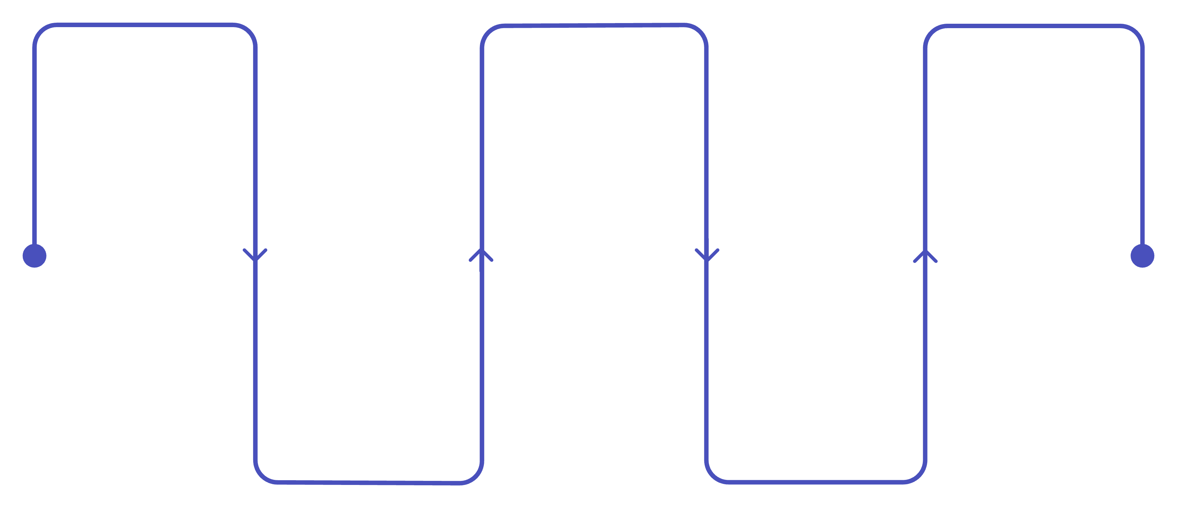
Step 1: Representing Risk with One Number
One Dimensional Vector (1D)
Low
High
Amit
0.1
0.9
0.85 (orange)
Medium
Rahul
0.5
0.9 (red)

Slide 9
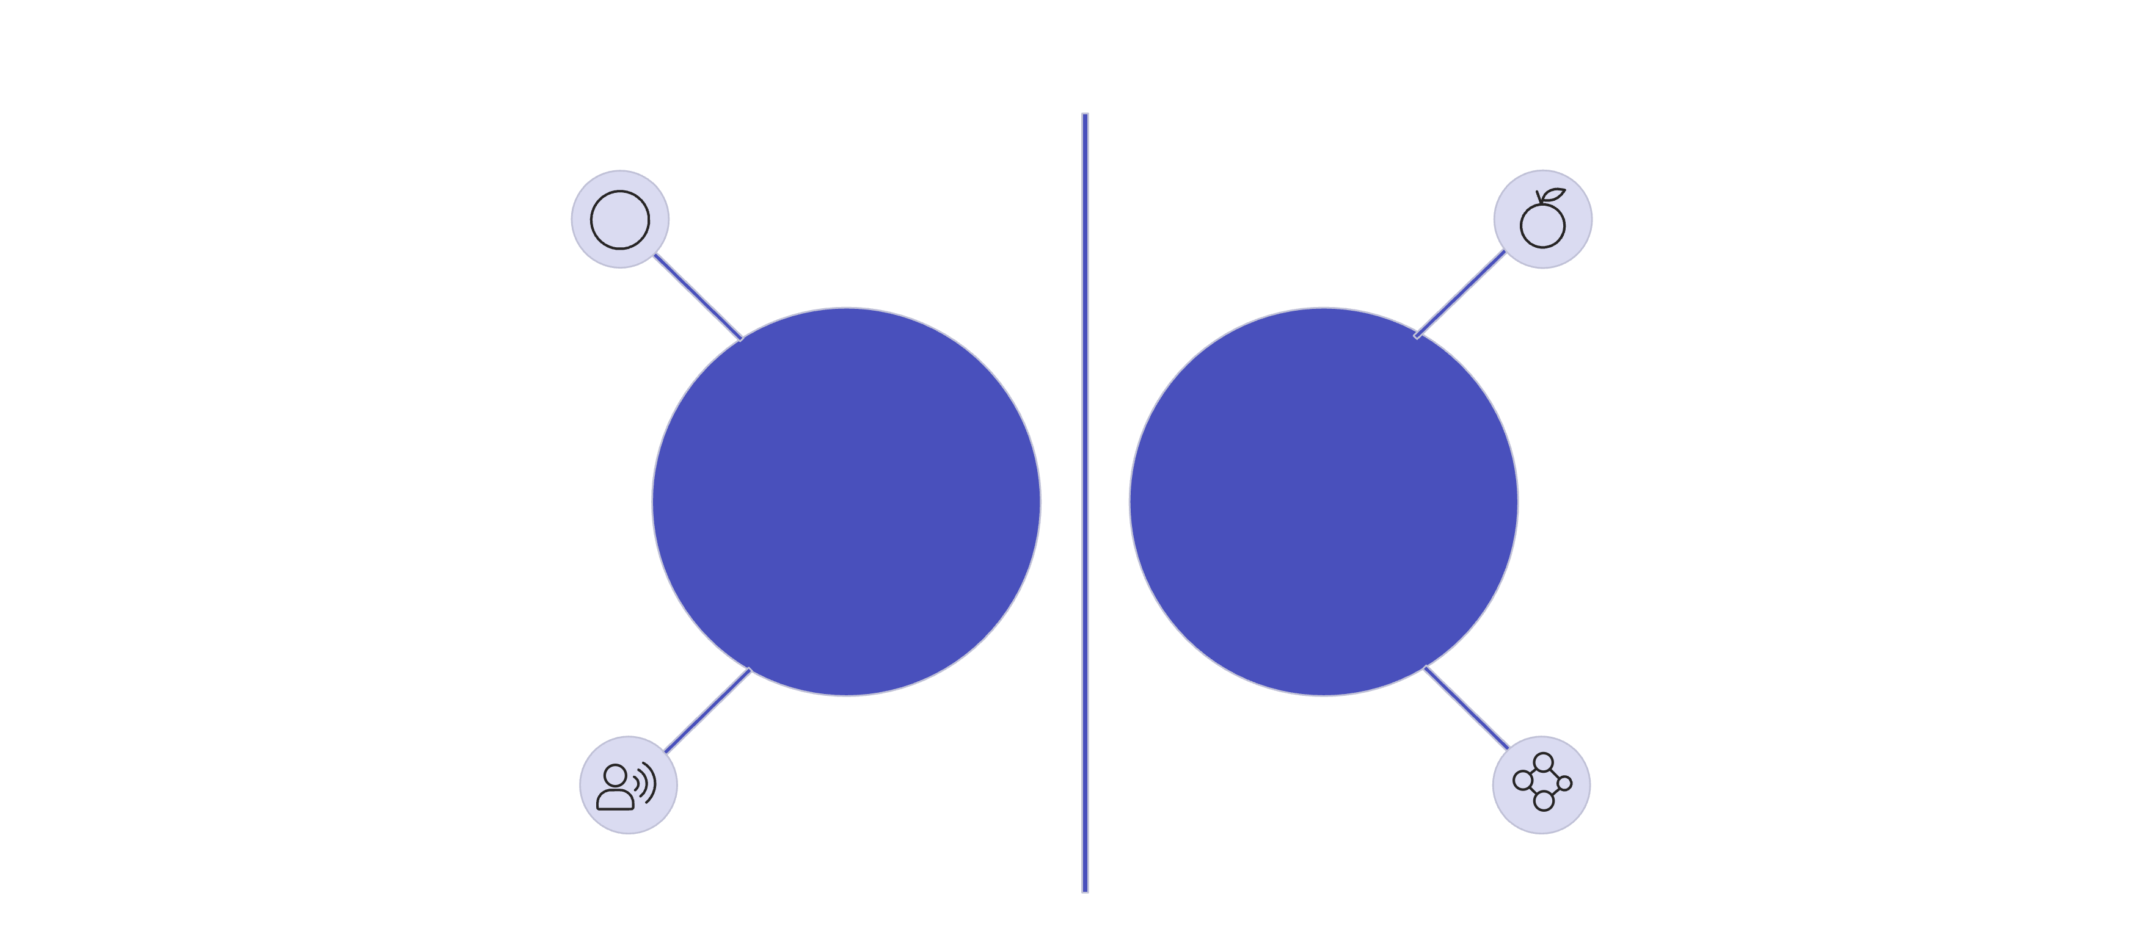




Step 2: Adding Behavior — Now We See Patterns
Two Dimensional Vector (2D)
Rahul (0.9, 0.8)
Amit (0.88, 0.82)
Foreign Transfers %
Transaction Speed
Very close proximity
Behavioral similarity
Behavioral Similarity Detected.

Slide 10
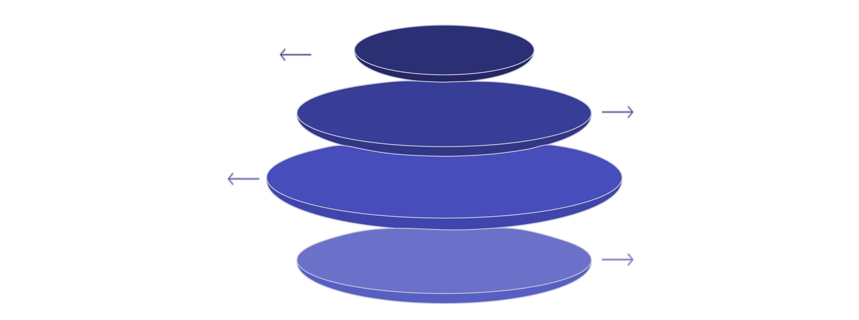
Slide 9: Step 3: Customer Becomes a Point in 3D Space
Three Dimensional Vector (3D)
Axis Definition
Txn Velocity, Foreign Exposure, Shell Company Links
Point Plot
Prominent glowing red point: Rahul Mehta
Suspicious Network
Cluster of luminous dots around the red point
Galaxy Style
Star-cluster aesthetic, isometric 3D cube

Slide 11

Real Systems Use Hundreds of Dimensions
N-Dimensional Vectors (Real AML Systems)
Customer Profile: Rahul
Name: Rahul Sharma
Age: 34
Location: Mumbai, India
Occupation: Software Engineer
Recent Activity:
Frequent international transfers to family members.
Online purchases for electronics and travel.
Investments in diversified stock portfolios.
Regular savings contributions.
Rahul's financial footprint is analyzed across numerous dimensions to identify patterns indicative of legitimate or suspicious behavior.
Behavioral DNA of a Customer

Slide 12
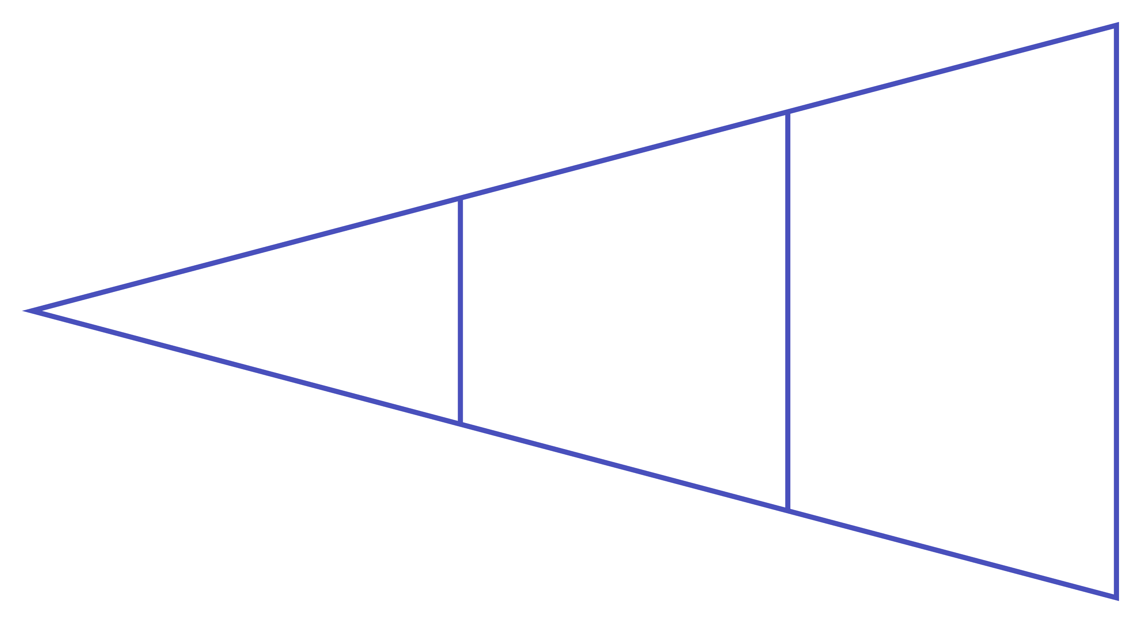
How a Vector Is Built (Real AML Example)
From Raw Data to Behavioral Fingerprint
Raw Data
Final Vector
Feature Scores

Slide 13
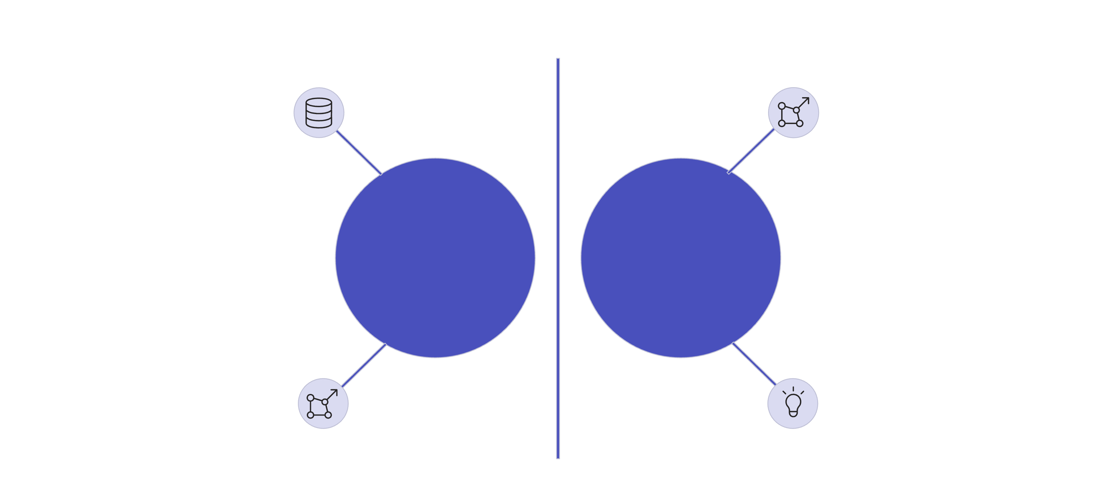

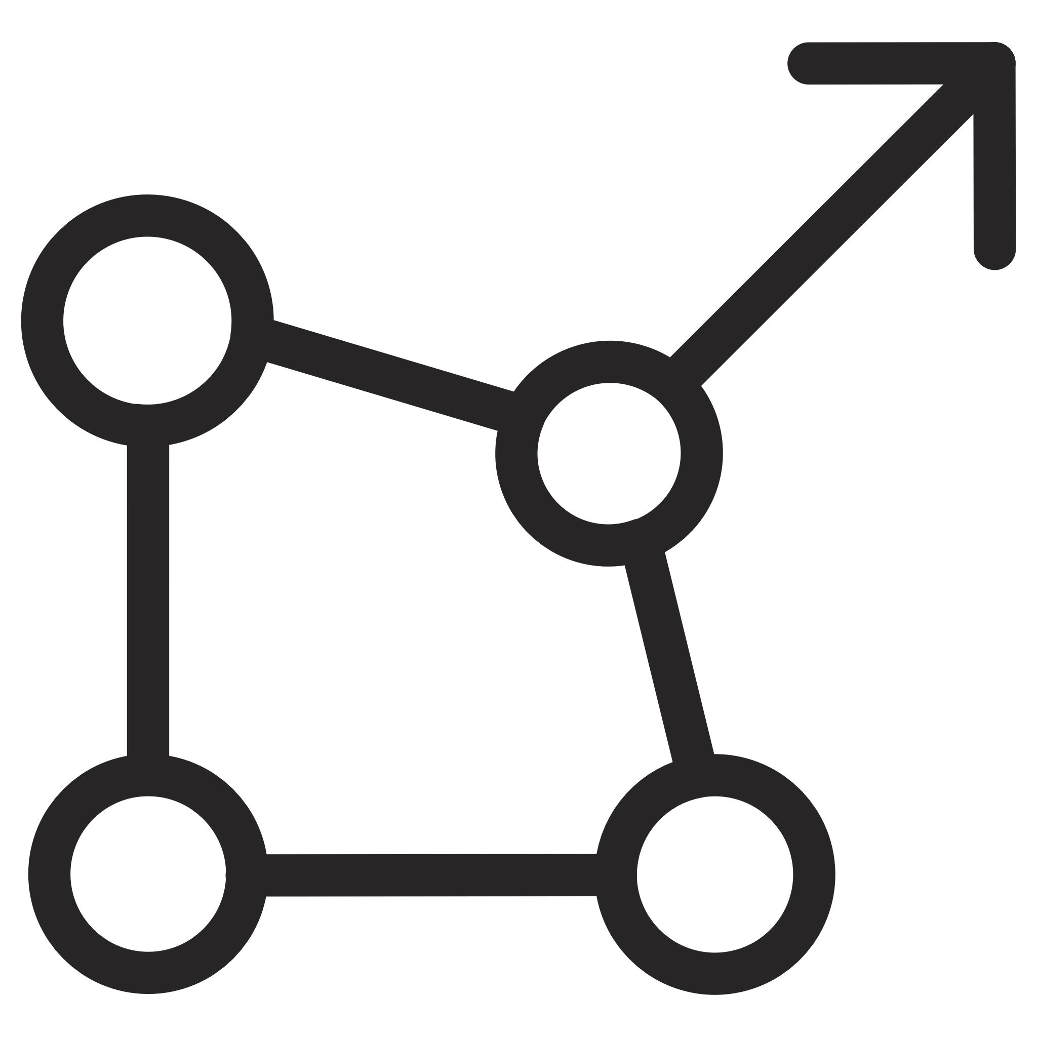
Why This Changes Everything
SQL Sees Rows. Vectors See Criminal Twins.
Traditional DB: No match found ❌
Vector DB: 94% Similarity Match ✅
Rahul Mehta
Amit Sharma
Glowing abstract vectors
Glowing abstract vectors

Slide 14


Searching in a World of Meaning
From Keyword Search to Meaning Search
Search Box: "fraud in dubai"
Search Box: "customers behaving like Rahul Mehta"
Returning exact keyword matches only.
Returning a cluster of similar profiles.
Keyword Search vs Semantic Search

Slide 15

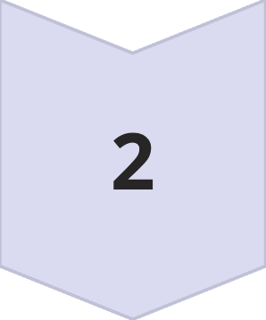
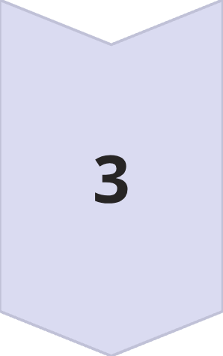
Query Becomes a Point in Space
How Vector Search Really Works
1) User Query
"Find customers like Rahul Mehta"
2) Embedding Model
Converts to [0.21, 0.77, 0.65, 0.89, …]
3) Vector Space
A galaxy of dots with the query dot appearing and nearby dots lighting up.
Closest Vectors = Most Similar Meaning

